Slide 1

An Efficient Way to Access Knowledge
Generating contextually relevant responses
Presented by: José Antonio González Castro
Notes:
This is an example of a Title Slide. We need to convey Life Is On in everything we do, so try to lead with compelling images that are vibrant, authentic, and human. The human element should be apparent and within the context of a segment that we touch.
To keep this PowerPoint template file size reduced, we included a small library of image choices in the Slide Master (under View). You can also get them from the SE Asset Library: https://schneiderelectric.telescopeondemand.com

Slide 2
The Problem
Thousands of documents
Thousands of documents
Thousands of documents
Tons of data that need to be searched manually
10 million cases
Support Cases (BFO)
Technical Publications
Online Help
SharePoint
Multiple places to look for information
Scattered data, with no cross-references
Waist of time getting irrelevant results
L2/L3 Support, Offer Support, Devs, Testers, OMO/PO, TPO…
Excesive task switching to provide support
Notes:
This is an example of a Text Slide. Reference the different layout options in the Slide Master (under the View tab) for different variations. Remember, our new Brand Guidelines call for clean and simple messages and design. Reference the PowerPoint Guidelines on the Brand Book for tips and useful information on creating effective presentations.

Slide 3

A much simpler way to search for things
Example 1: Searching for Specific Report
With AI:
User: “Find the Q3 2023 sales report.”
AI Chatbot: “Here is the Q2 2023 sales report: …”
With traditional systems:
User: Navigate to the document library.
User: Filter by document type.
User: Manually search through sales report.
User: Check dates to find the right report.
Example 2: Searching for Product Information
With IA:
User: “What are the advantages of LiFePO4 batteries compared with lead-acid batteries?”
AI Chatbot: “Here is a list of the advantages of LiFePO4 batteries compared to lead-acid: …”
With traditional systems:
User: Navigate to the technical manuals section.
User: Filter by product category.
User: Search through available models.
User: Check each document to find the right manual.

Slide 4
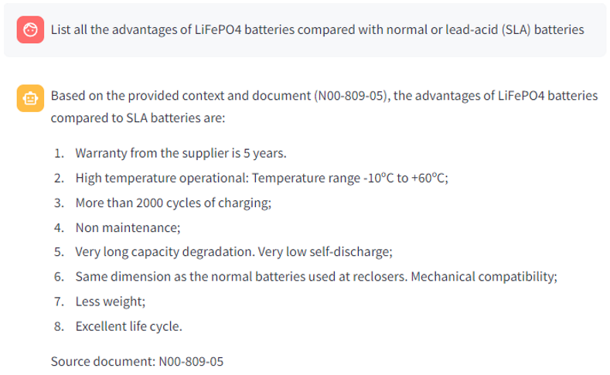
The Solution
Precise
Specific
Data source
LLM local
Remote Access
User feedback
Multiuser
Multilanguage
Notes:
This is an example of a Text Slide. Reference the different layout options in the Slide Master (under the View tab) for different variations. Remember, our new Brand Guidelines call for clean and simple messages and design. Reference the PowerPoint Guidelines on the Brand Book for tips and useful information on creating effective presentations.

Slide 5
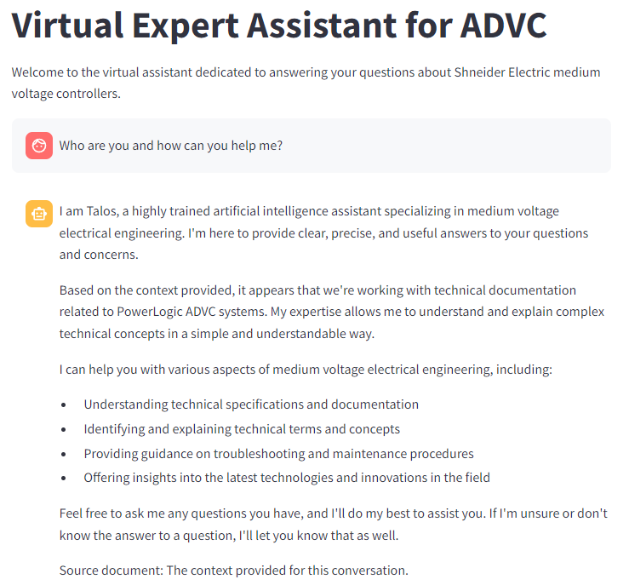
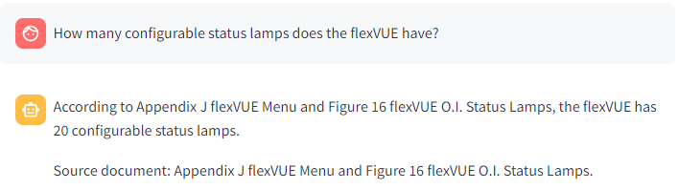
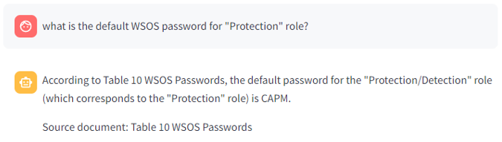
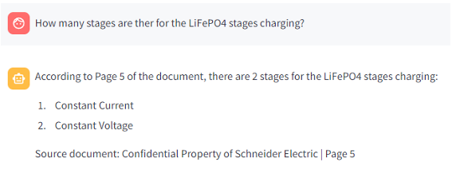
A few more real examples…
Tailored for each department!

Slide 6

Multiple Applications
Technical Support
Human Resources
Sales and Marketing
Training and Development
Project Management
Customer Service
Etc.
Notes:
This is an example of a Text Slide. Reference the different layout options in the Slide Master (under the View tab) for different variations. Remember, our new Brand Guidelines call for clean and simple messages and design. Reference the PowerPoint Guidelines on the Brand Book for tips and useful information on creating effective presentations.

Slide 7
Notes:
Closing slide

